Slide 1

efficient
faster
Instant Report
Reporting done right!
easier
Save Money!
Save Time!
Jewel
Kaush
Carlos
cloud
Smart
Real-time

Slide 2



So you are working on a typical day

Slide 3
Uh-oh!

Slide 4

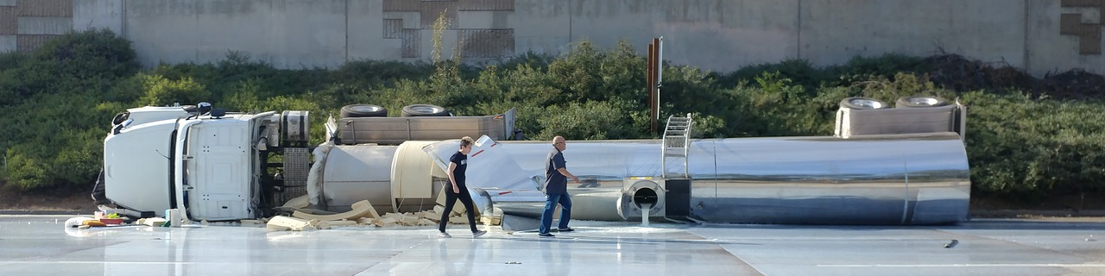



An incident has happened!

Slide 5

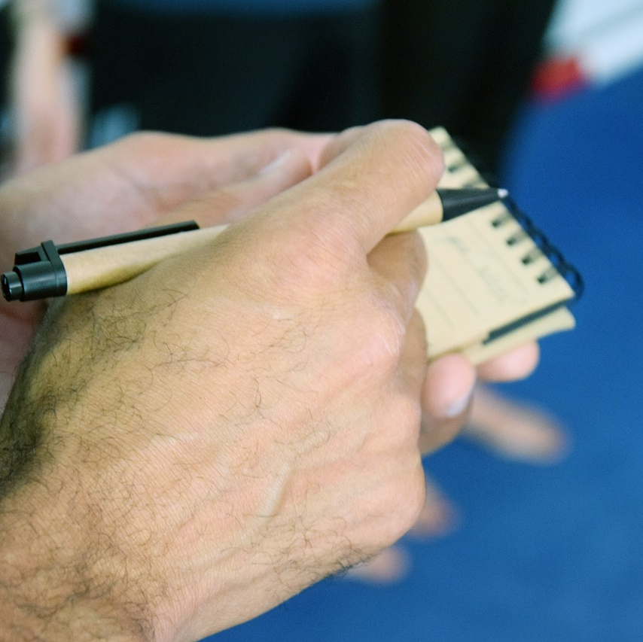

So what do you need to do?
Make calls
Wait for approvals Take action Request resources Remember all the details
take notes on paper
Gather evidence
Make some more calls
Wait for more approvals
Explain to your bosses
Explain to the Incident response team
etc. etc. etc. the list goes on…

Slide 6
And to make things worse…

Slide 7






When the Incident gets resolved, you have to…

Slide 8

Don’t Panic! The Solution is Here!
Instant Reorting

Slide 9

Instant Report
Great…another incident reporting tool!
More work… Right?

Slide 10

Instant Report
NO
Great…another incident reporting tool
More paper work…

Slide 11
What does InstApp Reporting actually do?
Eliminates paperwork
Sends information in real-time
Analyzes data
Simplifies the reporting process
Adapts to your needs, and those of your partners
SAVES TIME AND MONEY

Slide 12

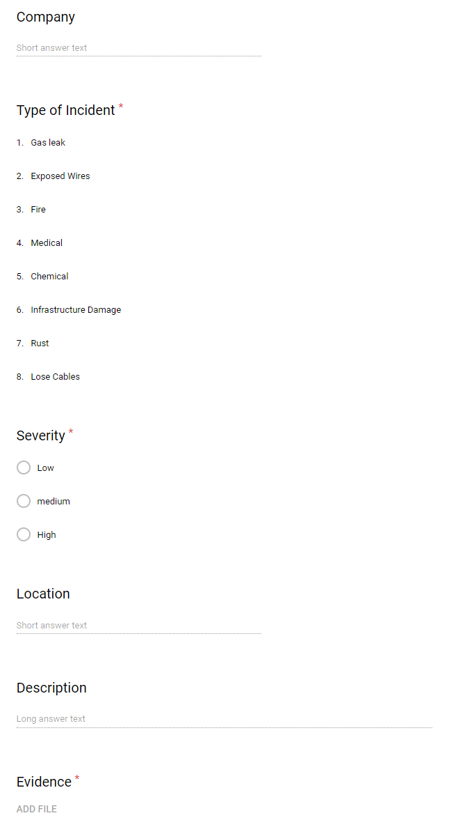



HOW?
User reports incident on device (with evidence included)
Data is sent to the database
People higher up in the chain of command see it
Support Center
Management
On-site personnel

Slide 13






Everyone benefits
No more paper forms
No more uploads to multiple platforms
No more waiting for approvals
No more having to be on site to view/report incidents
No dependency to a single provider
No dependency to an always active internet connection
Less SharePoint
Reduced human error
More accurate information
Easy to use!
Easy integration to existing systems
Wasted Time

Slide 14

“But I’m sure there’s gotta be plenty of other products in the market…”

Slide 15
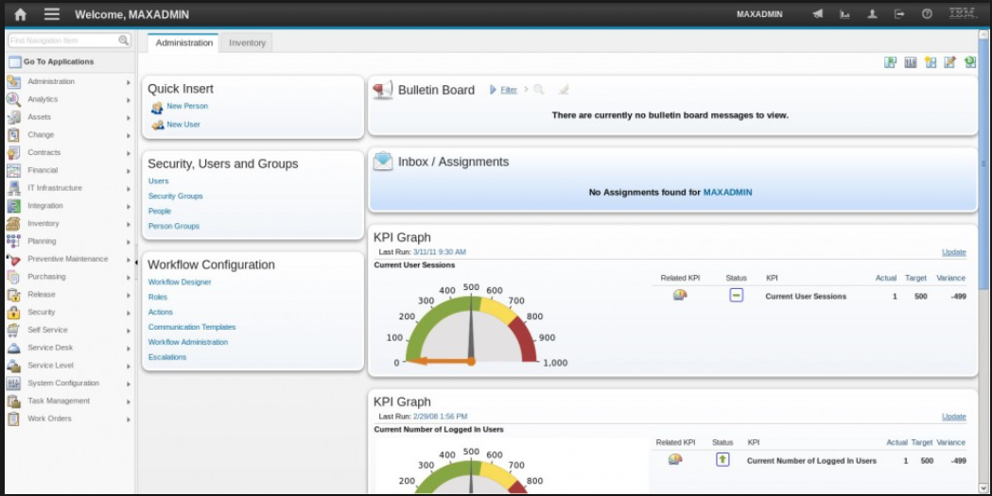
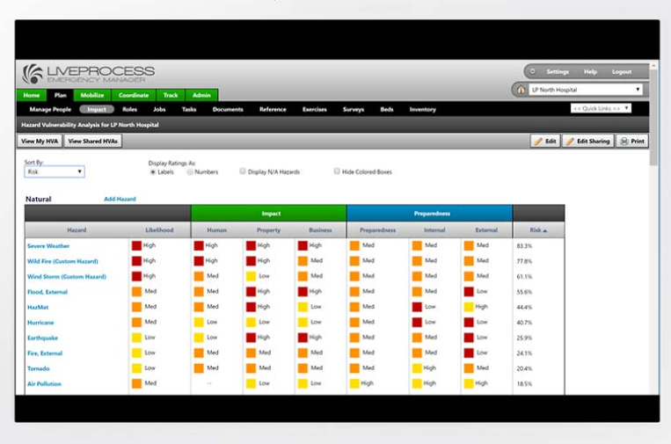
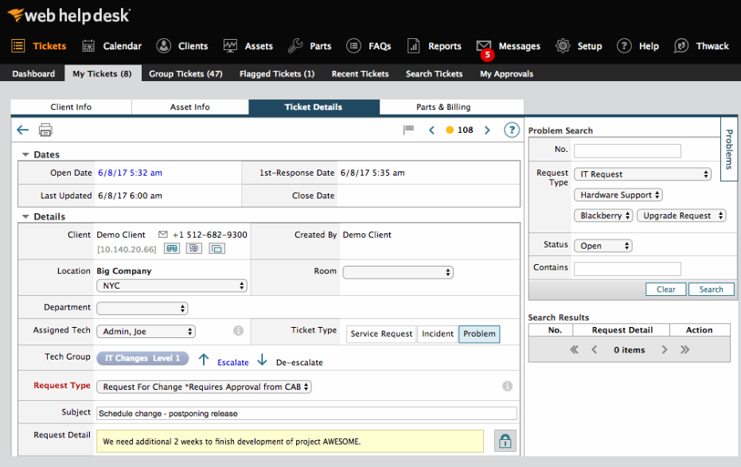
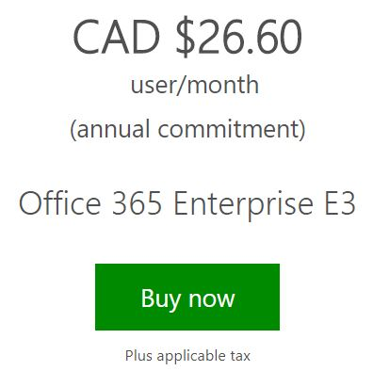





So what else is on the market?
Complicated
Monopoly
Expensive
Proprietary software: Expensive, Outdated, Hard to maintain/migrate

Slide 16
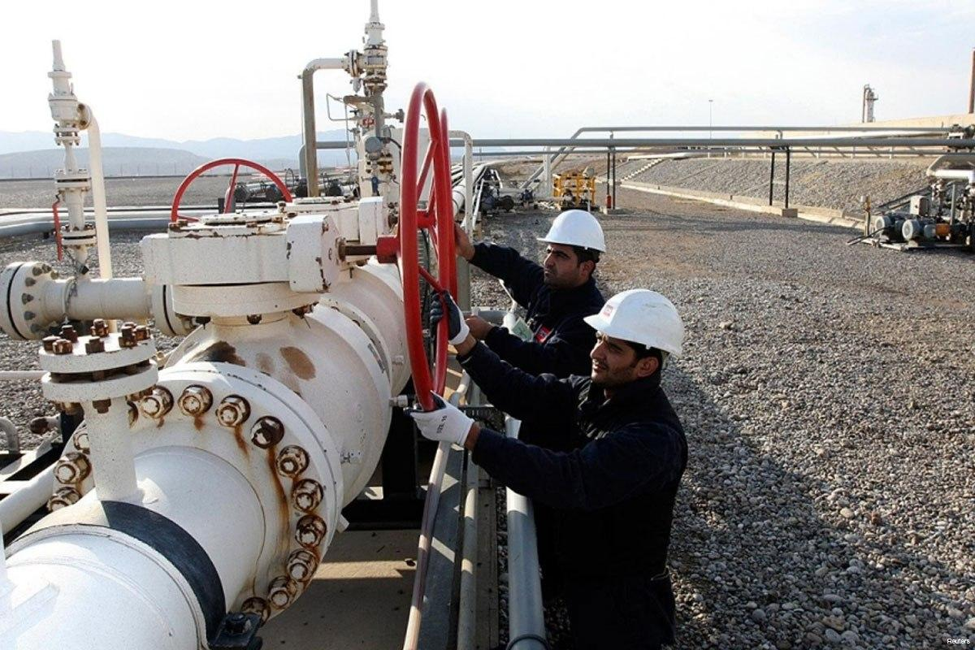
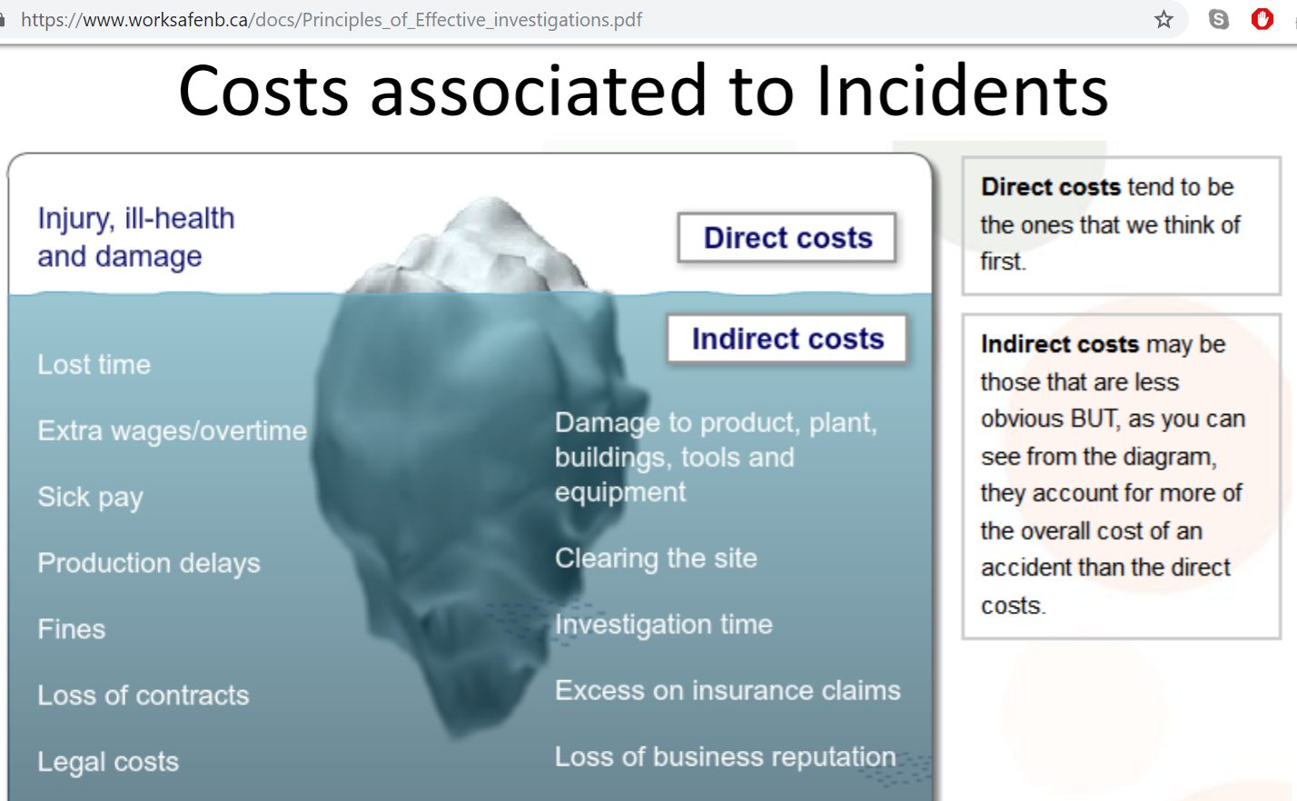
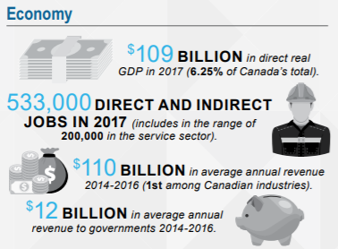
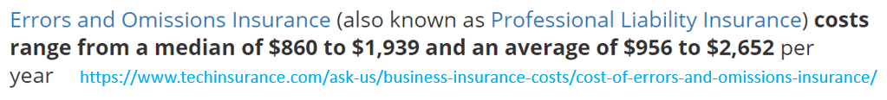
Something to think about…
“A study from Verdantix found that worldwide, EHS budgets will increase by more than 5 percent in 2018 and reveals new trends in technology preferences.”
https://www.ehstoday.com/safety-technology/how-are-ehs-managers-spending-their-budgets
Notes:
Avg. Salary for 1 person = $20
If you spend 1 hour/week documenting incidents….
$20 x 1 hour x 52 weeks =
$1000/year

Slide 17
Potential Markets
Oil & Gas
Mining
Construction
Healthcare
High risk
Remote

Slide 18
So what’s the business plan?

Slide 19
THE PLAN
Today
1 month
1 – 6 months
6 months to 1 year
+1 year
Phase 1: O&G Hackathon
MVP
Phase 2: Initial Investors
Onsite testing
Security Protocols
Auto-Error correction
System Integration
APIs for 3rd parties
Phase 3: Machine Learning
Data Analytics
Prediction Software
Pic to text
IoT- Integration with onsite sensors and available data
Phase 4: Expansion
Stronger marketing
Infrastructure upgrades
Robustness
Strategic Partners (NOIA for example)
Phase 5: Diversification
Apply existing products to other markets
Offline/Online capabilities
Cloud Based
Maintenance reports
Inspections
Inventory

Slide 20
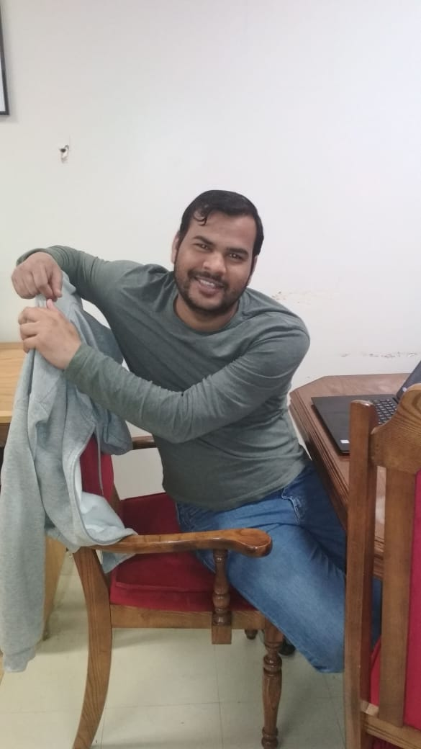

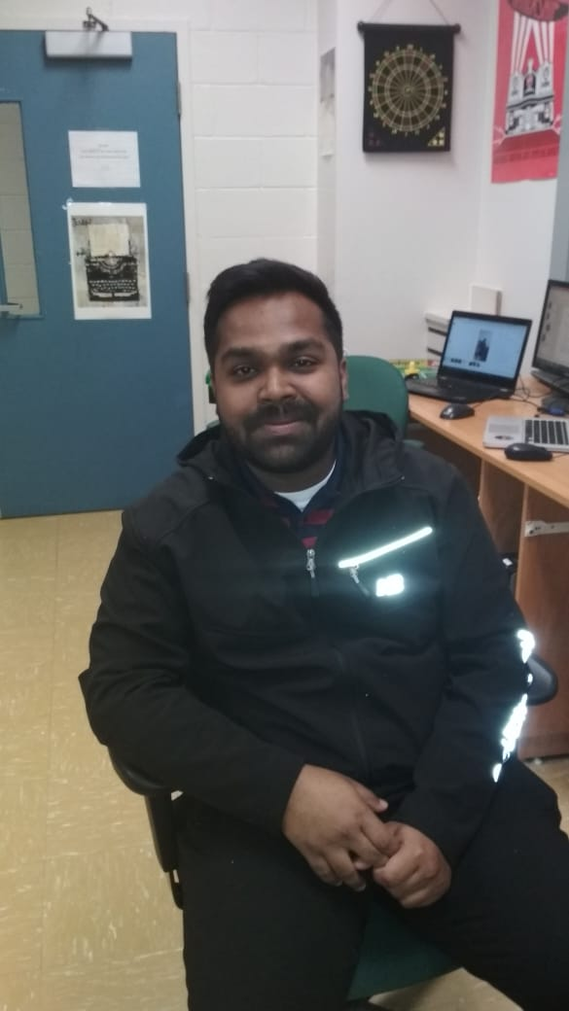
Who we are
The Brains
The Brawn
The looks

Slide 21



Slide 22

The DEMO

Slide 23
Save time and money, explain the benefits
Tell them what the value of using your product
And services
You want people to buy in
Potential customers here!
The great 8
Pain
Solution
Competition
Revenue streams
Traction
Team
ask

